Slide 1
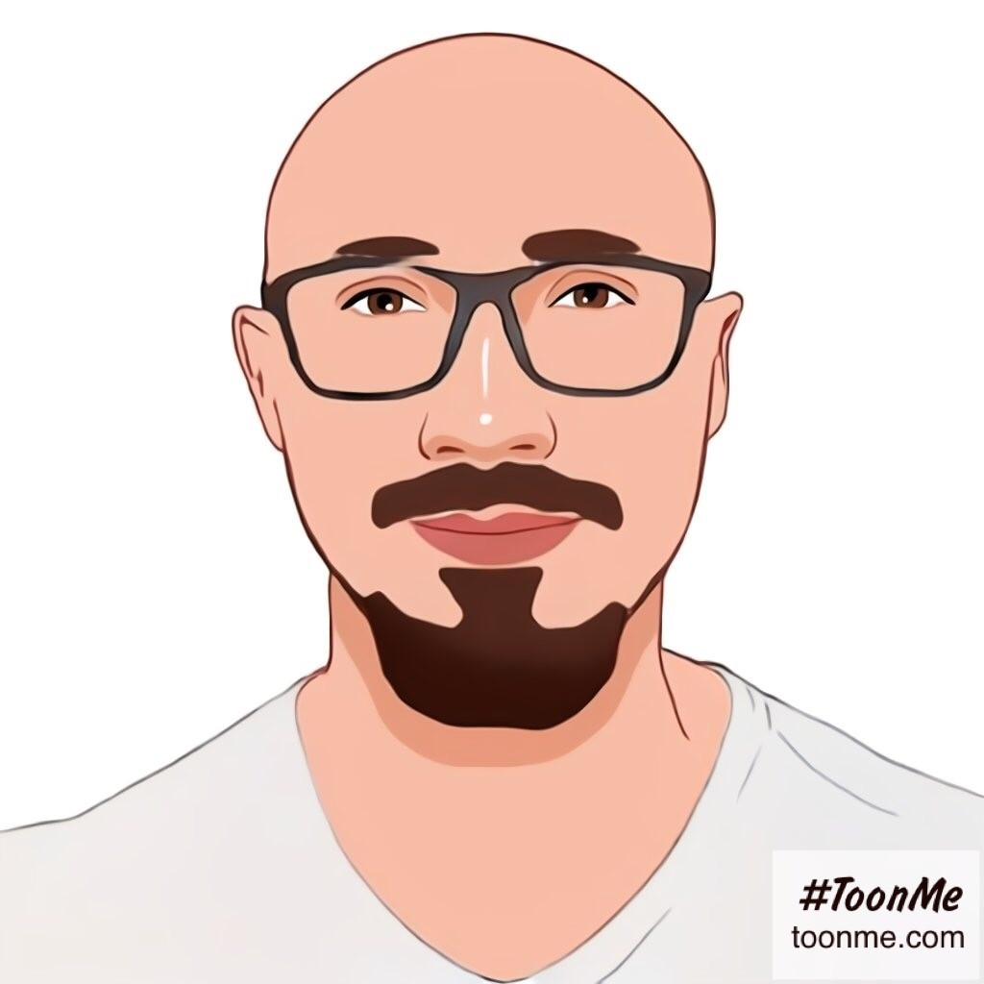

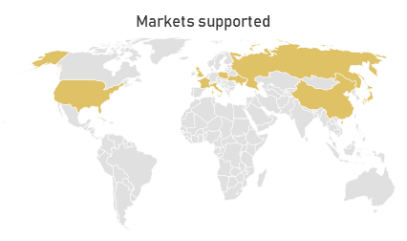


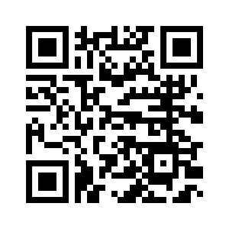
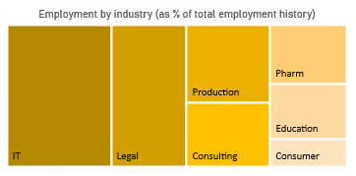
Hi there!
I am a Product Manager based in Poznan (Poland). I enjoy working on new solutions, designing processes and implement changes. My mission is to make sure business is efficient so I follow latest best practices and continuously learn new skills. I am enspired by companies which are looking to make a difference and want to make world a better place.
Mykola Korsikov
Agile (Scrum & Kanban)
Process modelling
HARD
SKILLS
Needs elicitation
Requirement gathering
BPMN
SDLC
UML
+48-513-523-937
Languages
korsikov@ukr.net
Business supported
https://www.linkedin.com/in/korsikov/
I agree to the processing of personal data contained in my CV for the needs necessary to carry out the recruitment, according to art. 13 para. 1 and 2 of Regulation (EU) 2016/679 of the Parliament and of the Council of 27 April 2016 on the protection of individuals with regard to the processing of personal data and the free movement of such data and the repeal of Directive 95/46 / EC (RODO)

Slide 2
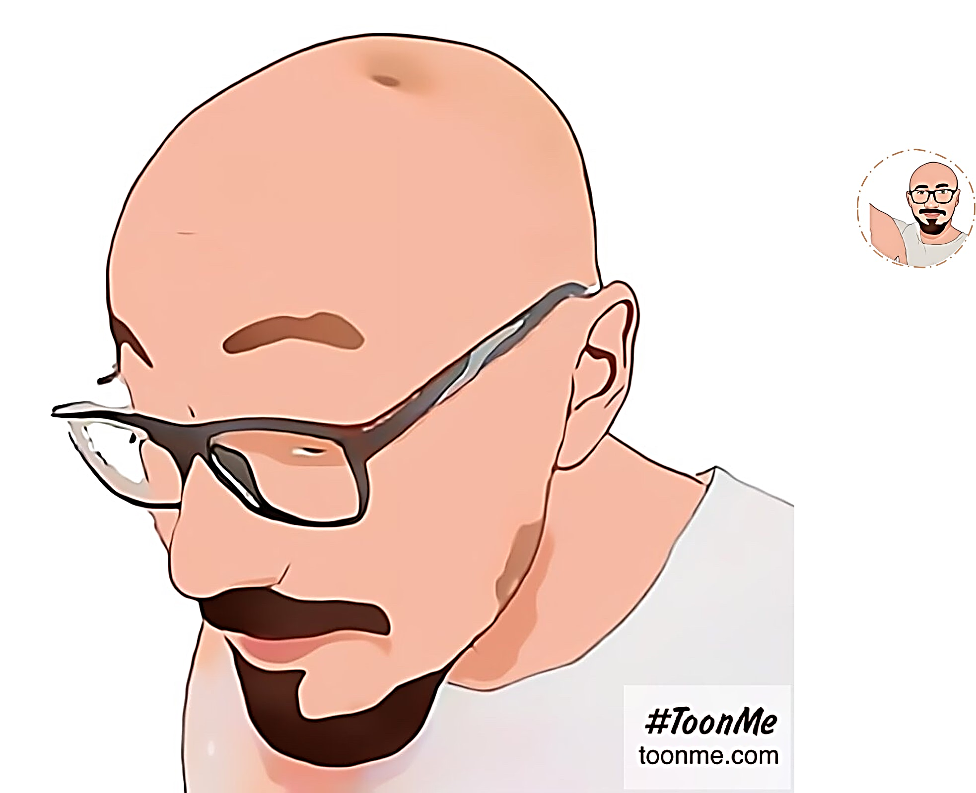
I understand that you want to know more about my responsibilities and tasks during my professional career so here is a detailed journey I covered so far. Reach out to find out more ☺

